Slide 1

Gatekeeper — USB Device Control & Monitoring Framework
Author: Om Fulsundar · Version 1.0

Slide 2
OVERVIEW
Presentation Agenda
01
02
03
Abstract
Motivation & Objectives
Architecture & Workflow
High-level summary of Gatekeeper.
Why Gatekeeper was developed and what it aims to achieve.
Overview of the system's design and operational flow.
04
05
06
Implementation & Demo
Testing & Results
Limitations & Future Work
Details on how it works and a live demonstration.
Validation of functionality and observed outcomes.
Current constraints and planned enhancements.
07
Conclusion
Key takeaways and next steps.

Slide 3




SUMMARY
Gatekeeper: At a Glance
Gatekeeper is a modular, open-source framework designed for real-time USB device control and monitoring on Linux systems.
Real-time Monitoring
Policy Enforcement
Detects USB plug/unplug events instantly.
Manages device access via allowlists/blocklists.
File Auditing
Daily Reporting
Records all file operations and computes SHA256 hashes.
Consolidates logs into comprehensive daily summaries.

Slide 4

CONTEXT
Motivation & Core Objectives
USB devices, while ubiquitous, represent significant security vulnerabilities. They are common vectors for malware, data exfiltration, and unauthorized access.
Common Attack Vectors: USB drives can introduce malware or facilitate data theft.
Lack of Visibility: Enterprises often lack clear visibility into USB device usage.
Audit Trail Deficiency: Insufficient logging for forensic analysis post-incident.
Our Objectives:
Detect & Identify: Accurately identify connected USB devices.
Enforce Policy: Implement robust allowlist/blocklist mechanisms.
Audit Transfers: Log all file operations and changes for forensic readiness.
Generate Reports: Provide actionable insights through comprehensive daily reports.

Slide 5

ARCHITECTURE
High-Level Architecture :
Modular Design
Report
Monitor
Summarize operational data
Observe system activity
Orchestrator Architecture
Gatekeeper adopts a modular architecture, enhancing maintainability and scalability. Each component performs a specific function, orchestrated by the central main.py script. All operational logs are systematically stored for review and analysis.
Audit
Identify
Track actions and changes
Detect relevant events
Alert
Policy
Notify on incidents
Enforce rules and logic

Slide 6





WORKFLOW
Execution Workflow: Decision & Action
Enforce Outcome
Mount or log and stop
Policy Decision
ALLOW or DENY
Identify Device
Determine device attributes
Detect USB Event
Gatekeeper notices device
This flowchart illustrates Gatekeeper's operational flow from device detection to policy enforcement and subsequent actions. Crucially, any denied device is immediately logged and halted, preventing potential security breaches.

Slide 7


MODULE DETAILS
Module Deep Dive: Monitor & Identify
Monitor Module
Identify Module
Event Detection: Utilizes pyudev for real-time plug/unplug events.
Baseline Enumeration: Performs initial scan of all connected devices upon startup.
Continuous Observation: Actively listens for new device connections.
Key Attributes Extraction: Extracts critical identifiers like Vendor ID, Product ID, and Serial Number.
Device Fingerprinting: Creates a unique signature for each device based on these attributes.
Categorization: Prepares device data for policy evaluation.

Slide 8


MODULE DETAILS
Module Deep Dive: Policy & Alert
Policy Module
Alert Module
Rule-Based Decisions: Compares device attributes against predefined allowlists and blocklists.
Dynamic Control: Determines whether a detected device should be granted or denied access.
Extensible: Designed to allow for future complex policy rules.
Instant Notification: Provides immediate console notifications for all policy decisions.
Persistent Logging: Records all alerts and decisions to usb_alert.log for historical tracking.
Integration Ready: Can be adapted for integration with broader security information and event management (SIEM) systems.

Slide 9


MODULE DETAILS
Module Deep Dive: Audit & Report
Audit Module
Report Module
Watchdog Integration: Actively monitors specified mount paths for file system events.
Event Recording: Logs all file creations, modifications, and deletions.
Integrity Verification: Computes SHA256 hashes of transferred files for forensic traceability.
Log Aggregation: Consolidates data from various log files into a single, digestible report.
Daily Summaries: Generates daily reports named gatekeeper_report_YYYY-MM-DD.txt.
Actionable Insights: Provides a clear overview of all USB activities for security review.

Slide 10
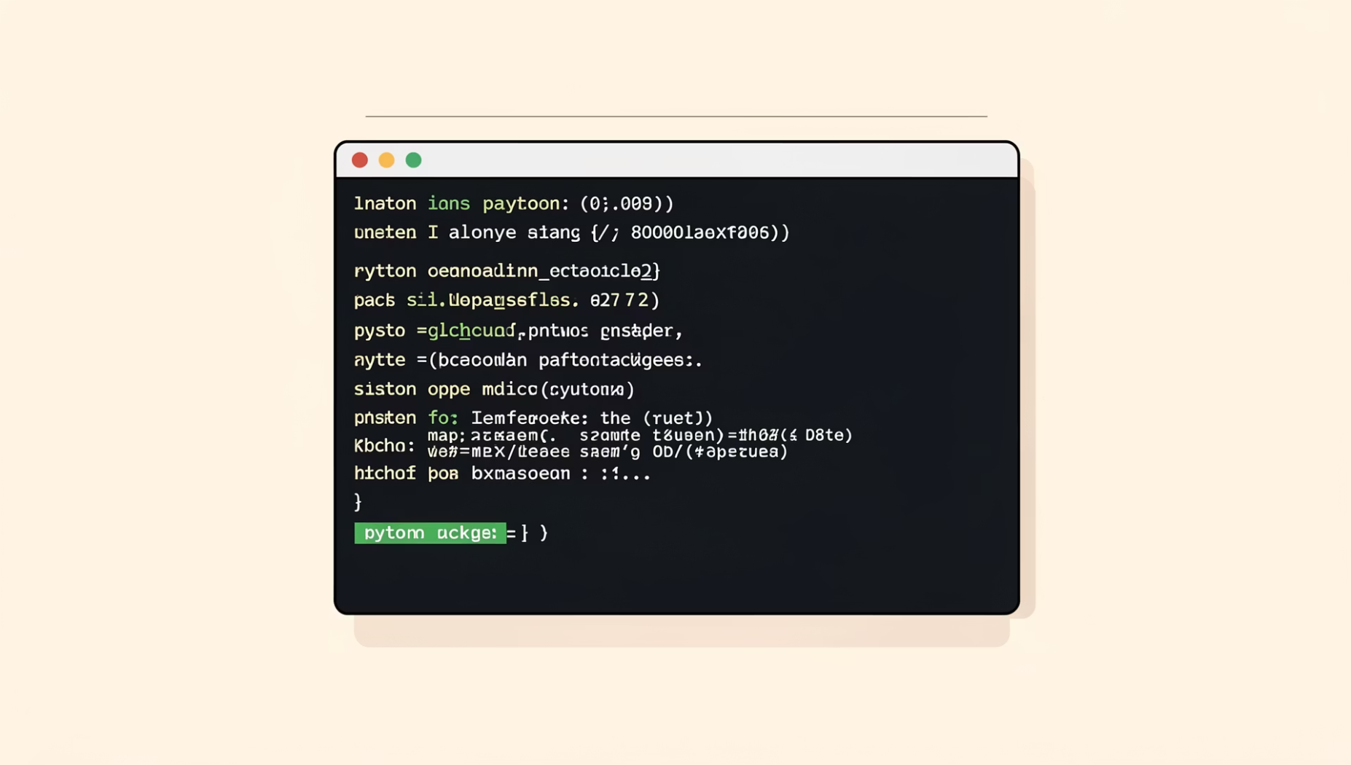

DEPLOYMENT
Installation & Dependencies
Installation Command:
Python Version: Requires Python 3.8 or newer.
Core Libraries:
pyudev: For robust USB device event detection.
watchdog: For efficient file system monitoring and auditing.
pip install pyudev watchdog
Please note: Gatekeeper is primarily developed and tested on Linux environments. While a future Windows backend is planned, current functionality is Linux-centric.

Slide 11

Limitations & Future Work
Limitations:
Linux‑centric
mount polling
spoofing risk
no content scanning
Future:
config file
Windows backend
log rotation
SIEM integration
structured exports

Slide 12
Conclusion :
Gatekeeper is a solid proof‑of‑concept that balances simplicity with forensic usefulness. It is an effective teaching tool and a practical starting point for organizations that want to add removable‑media visibility to their security posture. With modest enhancements, it can evolve into a more resilient component of an organization’s endpoint defense strategy.
Thank You !

